Slide 1


Slide 2
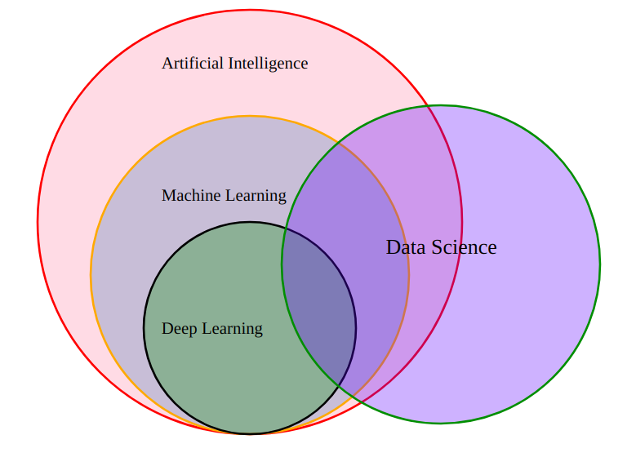

Slide 3
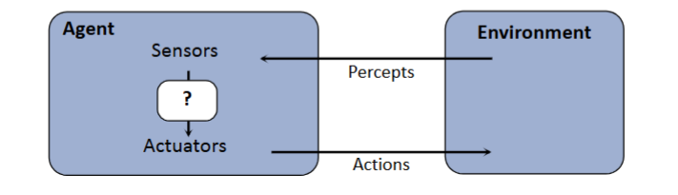

Slide 4
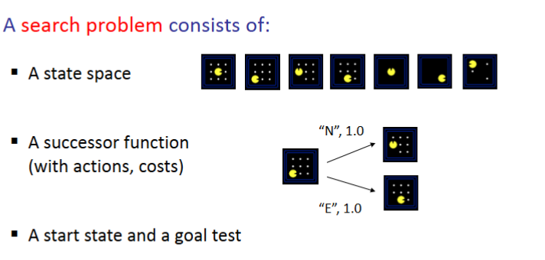

Slide 5
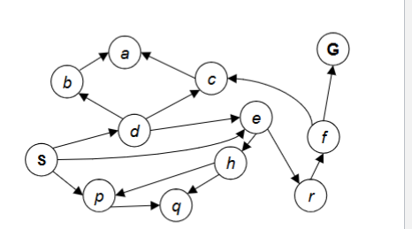

Slide 6
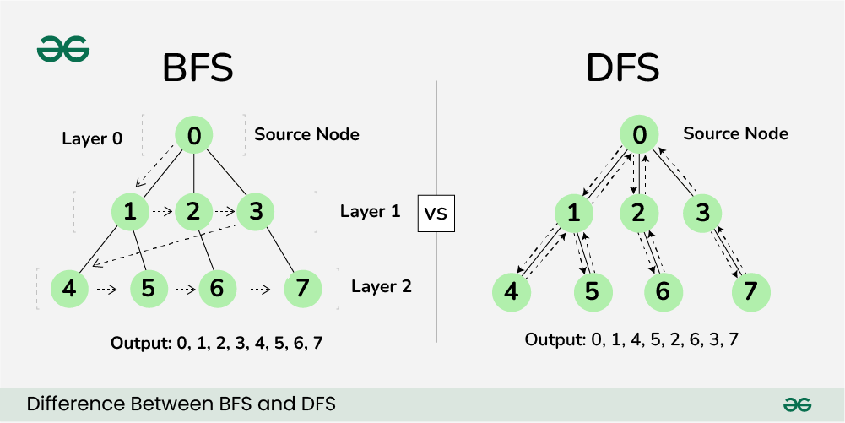
Notes:
Uninformed Search.

Slide 7
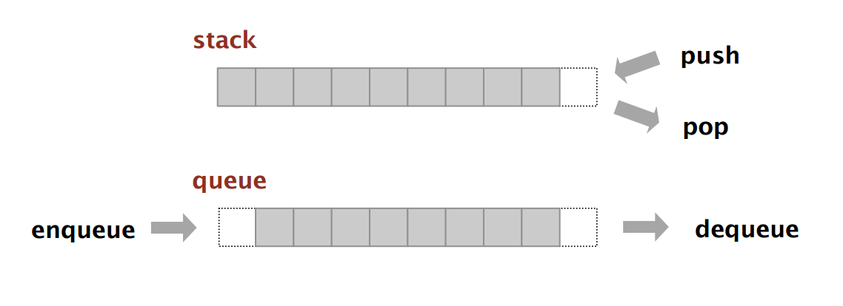
Notes:
Fringe concept.

Slide 8
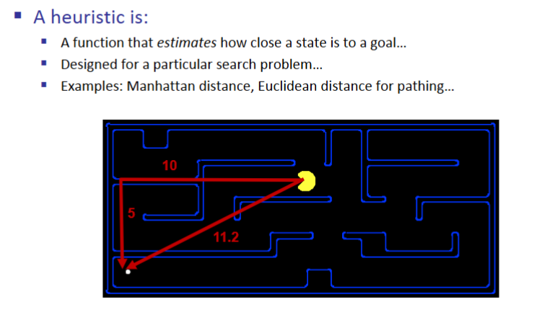
Notes:
Informed search using a Guess/Estimate.

Slide 9
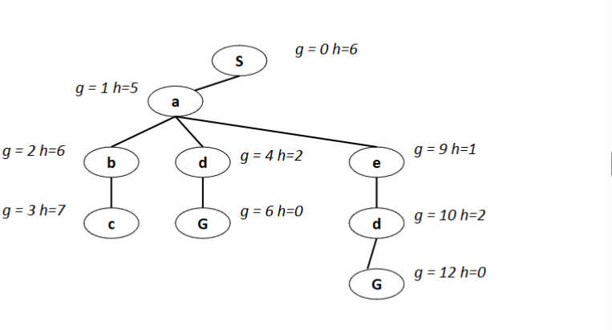
Notes:
f(n) = g(n) + h(n)
g(n) (Cost so far): How much gas have we already used? (Distance from Start)
h(n) (Heuristic): How much gas do we guess we need to finish? (Estimated distance to Goal)

Slide 10
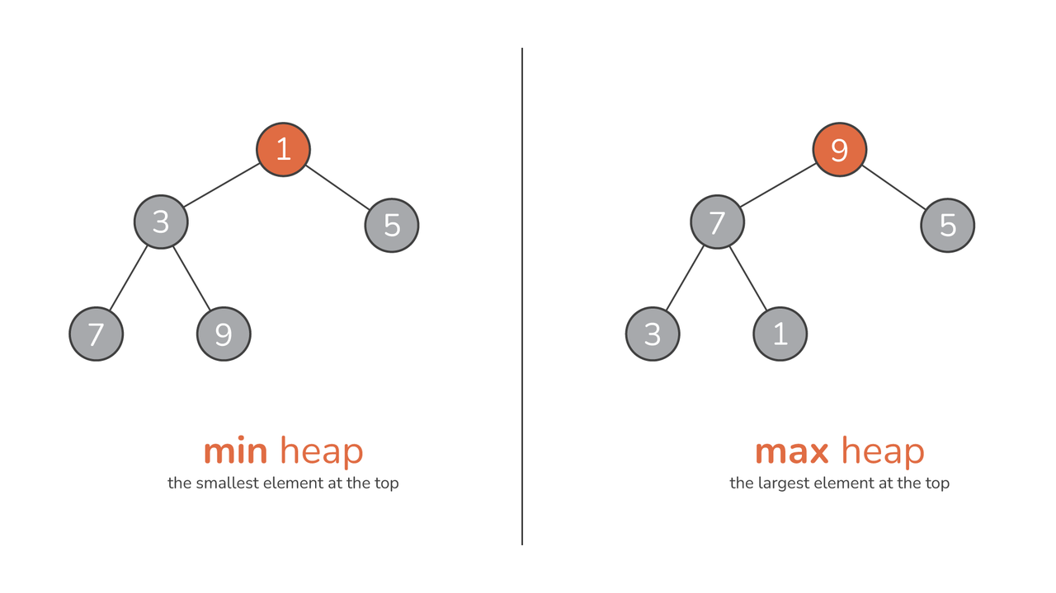

Slide 11
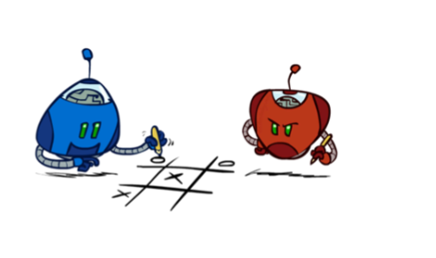
Notes:
Adverserial search

Slide 12
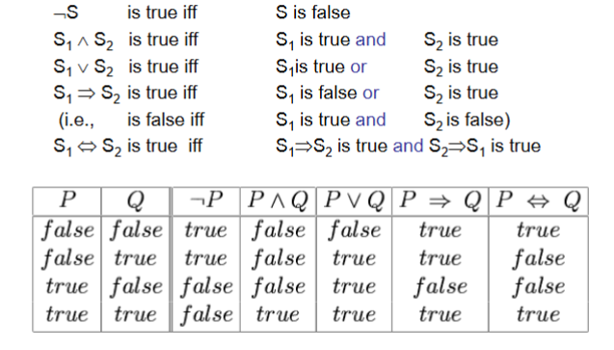
Notes:
Prepositional Logic.

Slide 13
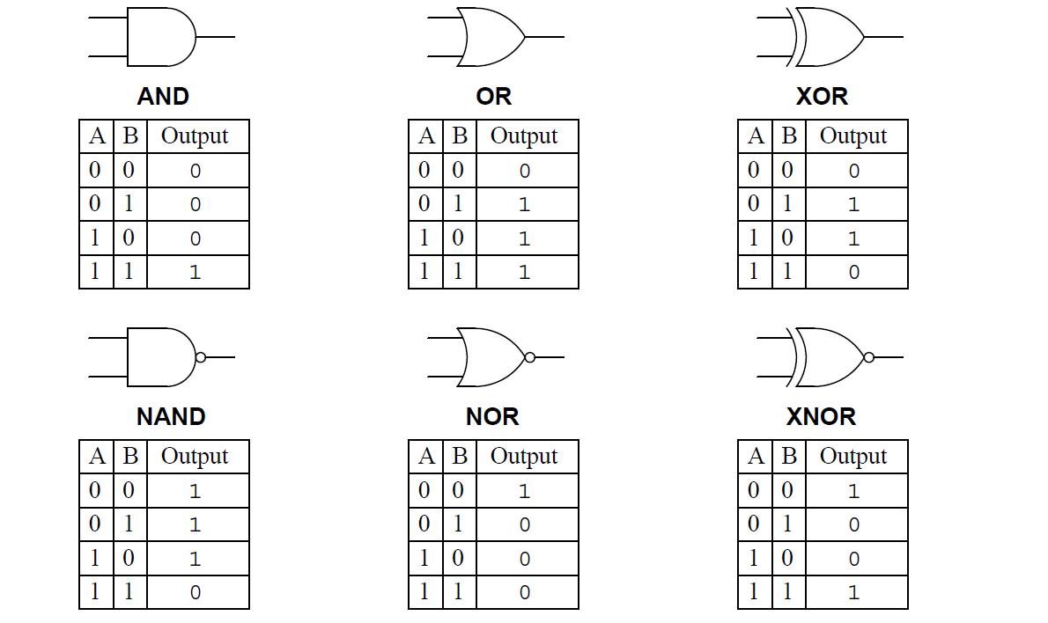

Slide 14
Notes:
Give and example and work it.

Slide 15
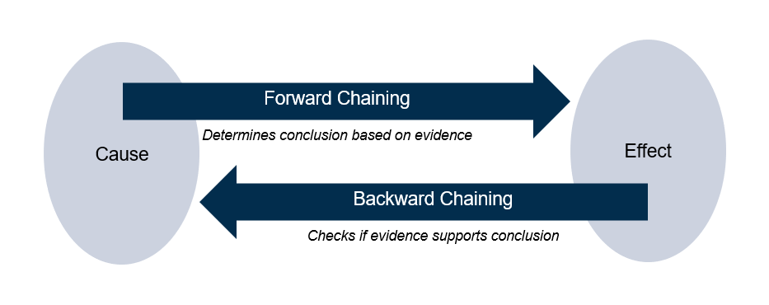
Notes:
Give an example and work it.

Slide 16
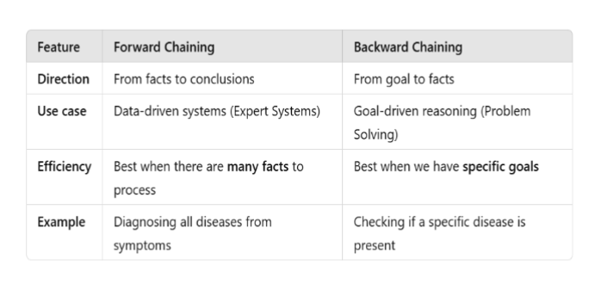

Slide 17


